Slide 1
Announcements
Project 3 released by Saturday (but maybe a day or two sooner).
Significant project so don’t put off starting until the last minute!
At the very least, make sure you can compile and run the starter code (MapServer.java) by the end of the weekend!
On par with project 2 in scale, but it’s a solo project.
This project will be the closest to what you might do at an internship.
Using datasets.
Working with and improving upon an existing code base.
Reading javadocs and documentation.
Use of many tools at once (webbrowser, Maven, IntelliJ).

Slide 2
Warm-up Problem
Given a undirected graph, determine if it contains any cycles.
May use any data structure or algorithm from the course so far.
3
1
6
4
0
2
5

Slide 3
Warm-up Problem
Given a undirected graph, determine if it contains any cycles.
May use any data structure or algorithm from the course so far.
Approach 1: Do DFS from 0 (arbitrary vertex).
Keep going until you see a marked vertex.
Potential danger:
1 looks back at 0 and sees marked.
Solution: Just don’t count the node you came from.
Worst case runtime: Θ(V + E) -- do study guide problems to reinforce this.
3
1
6
0
4
2
5

Slide 4
Warm-up Problem
Given a undirected graph, determine if it contains any cycles.
May use any data structure or algorithm from the course so far.
Approach 2: Use a WeightedQuickUnionUF object.
For each edge, check if the two vertices are connected.
If not, union them.
If so, there is a cycle.
Worst case runtime: O(V + E log* V) if we have path compression.
3
1
6
0
4
2
5

Slide 5
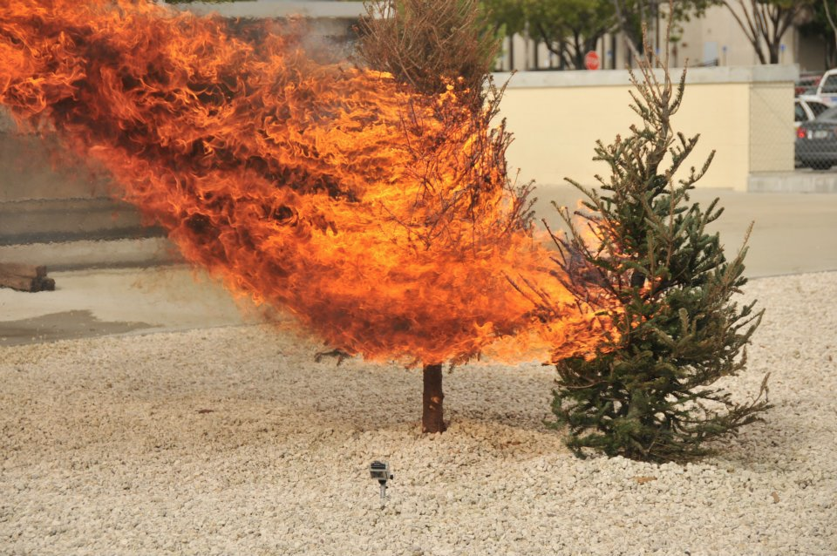
CS61B
Lecture 30: Graphs IV: Minimum Spanning Trees
MST, Cut Property, Generic MST Algorithm
Prim’s Algorithm
Kruskal’s Algorithm

Slide 6
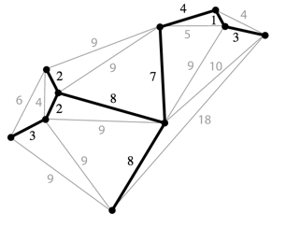
Spanning Trees
Given an undirected graph, a spanning tree T is a subgraph of G, where T:
Is connected.
Is acyclic.
Includes all of the vertices.
Example:
Spanning tree is the black edges and vertices.
These two properties make it a tree.
This makes it spanning.
A minimum spanning tree is a spanning tree of minimum total weight.
Example: Directly connecting buildings by power lines.

Slide 7
Spanning Trees

Slide 8
How Many are Spanning Trees? http://yellkey.com/fall

Slide 9
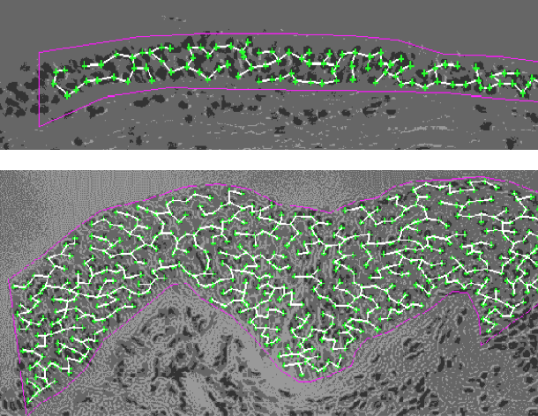
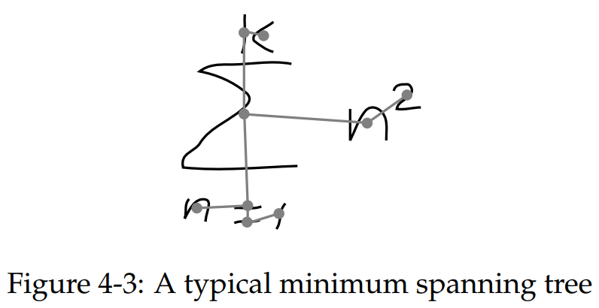
MST Applications
Old school handwriting recognition (left (link))
Medical imaging (e.g. arrangement of nuclei in cancer cells (right))
For more, see: http://www.ics.uci.edu/~eppstein/gina/mst.html

Slide 10
MST
Find the MST for the graph.
B
C
2
2
s
2
A
3
D

Slide 11
MST
Find the MST for the graph.
B
C
2
2
s
2
A
3
D

Slide 12
MST vs. SPT, http://yellkey.com/approach
Is the MST for this graph also a shortest paths tree? If so, using which node as the starting node for this SPT?
A
B
C
D
No SPT is an MST.
B
C
2
2
s
2
A
3
D

Slide 13
MST vs. SPT, http://yellkey.com/approach
Is the MST for this graph also a shortest paths tree? If so, using which node as the starting node for this SPT?
A
B
C
D
No SPT is an MST.
B
C
2
2
2
A
3
D
s = D
Doesn’t work for s = D!

Slide 14
MST vs. SPT, http://yellkey.com/approach
Is the MST for this graph also a shortest paths tree? If so, using which node as the starting node for this SPT?
A
B
C
D
No SPT is an MST.
SPT from A
B
C
2
2
s
2
A
3
D
s
SPT from B,
MST
B
C
2
2
2
A
3
D
s
SPT from C
SPT from D
B
C
2
2
s
s
2
A
3
D

Slide 15
MST vs. SPT, http://yellkey.com/approach
A shortest paths tree depends on the start vertex:
Because it tells you how to get from a source to EVERYTHING.
There is no source for a MST.
Nonetheless, the MST sometimes happens to be an SPT for a specific vertex.

Slide 16
Spanning Tree, http://yellkey.com/maintain
Give a valid MST for the graph below.
Hard B level question: Is there a node whose SPT is also the MST?
Yes
No
1
1
1
1
1
1
2
2
0
0
1
2
2
1
1
1
1
1
Notes:
SPLIT INTO TWO PROBLEMS: What is the MST? And is there a node for which it is the SPT?

Slide 17
Spanning Tree
Give a valid MST for the graph below.
Is there a node whose SPT is also the MST? [see next slide]
1
1
1
1
1
1
2
2
0
0
1
2
2
1
1
1
1
1

Slide 18
Spanning Tree
Give a valid MST for the graph below.
Is there a node whose SPT is also the MST?
No! Minimum spanning tree must include only 2 of the 2 weight edges, but the SPT always includes at least 3 of the 2 weight edges.
1
1
1
1
1
1
2
2
0
0
1
2
2
1
1
1
1
1
Example SPT from bottom left vertex:
1
1
1
1
1
1
2
2
0
0
1
2
2
1
1
1
1
1

Slide 19
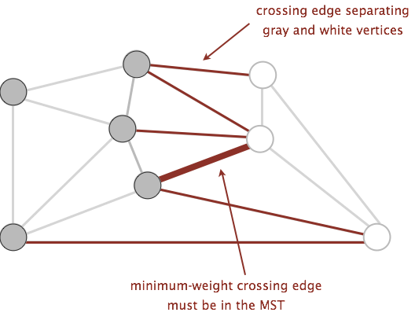
A Useful Tool for Finding the MST: Cut Property
A cut is an assignment of a graph’s nodes to two non-empty sets.
A crossing edge is an edge which connects a node from one set to a node from the other set.
Cut property: Given any cut, minimum weight crossing edge is in the MST.
For rest of today, we’ll assume edge weights are unique.
Notes:
Suppose it were suboptimal.

Slide 20
Prim’s Runtime
Exactly like Dijkstra’s runtime:
Insertions: V, each costing O(log V) time.
Delete-min: V, each costing O(log V) time.
DecreasePriority: E, each costing O(log V) time.
Data structure not discussed in class.
Overall runtime, assuming E > V, we have O(E log V) runtime.
Operation | Number of Times | Time per Operation | Total Time
Insert | V | O(log V) | O(V log V)
Delete minimum | V | O(log V) | O(V log V)
Decrease priority | E | O(log V) | O(E log V)

Slide 21
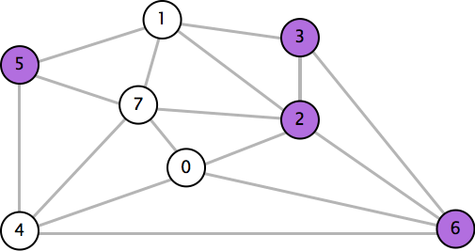
Cut Property in Action: http://yellkey.com/each
Which edge is the minimum weight edge crossing the cut {2, 3, 5, 6}?
0-7 0.16
2-3 0.17
1-7 0.19
0-2 0.26
5-7 0.28
1-3 0.29
1-5 0.32
2-7 0.34
4-5 0.35
1-2 0.36
4-7 0.37
0-4 0.38
6-2 0.40
3-6 0.52
6-0 0.58
6-4 0.93

Slide 22
Cut Property in Action
Which edge is the minimum weight edge crossing the cut {2, 3, 5, 6}?
0-2. Must be part of the MST!
0-7 0.16
2-3 0.17
1-7 0.19
0-2 0.26
5-7 0.28
1-3 0.29
1-5 0.32
2-7 0.34
4-5 0.35
1-2 0.36
4-7 0.37
0-4 0.38
6-2 0.40
3-6 0.52
6-0 0.58
6-4 0.93

Slide 23
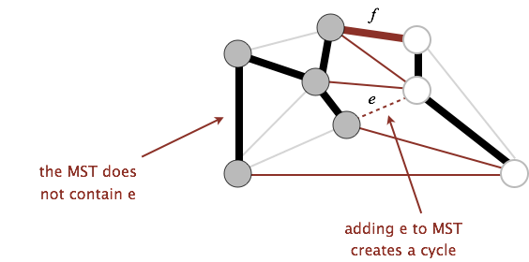
Cut Property Proof
Suppose that the minimum crossing edge e were not in the MST.
Adding e to the MST creates a cycle.
Some other edge f must also be a crossing edge.
Removing f and adding e is a lower weight spanning tree.
Contradiction!

Slide 24
Generic MST Finding Algorithm
Start with no edges in the MST.
Find a cut that has no crossing edges in the MST.
Add smallest crossing edge to the MST.
Repeat until V-1 edges.
This should work, but we need some way of finding a cut with no crossing edges!
Random isn’t a very good idea.

Slide 25
Prim’s Algorithm

Slide 26
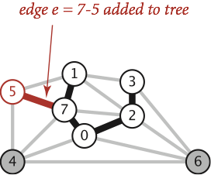
Prim’s Algorithm
Start from some arbitrary start node.
Repeatedly add shortest edge (mark black) that has one node inside the MST under construction.
Repeat until V-1 edges.
Conceptual Prim’s Algorithm Demo (Link)
Why does Prim’s work? Special case of generic algorithm.
Suppose we add edge e = v->w.
Side 1 of cut is all vertices connected to start, side 2 is all the others.
No crossing edge is black (all connected edges on side 1).
No crossing edge has lower weight (consider in increasing order).

Slide 27
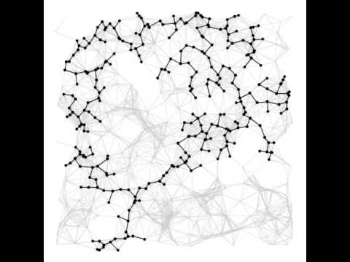
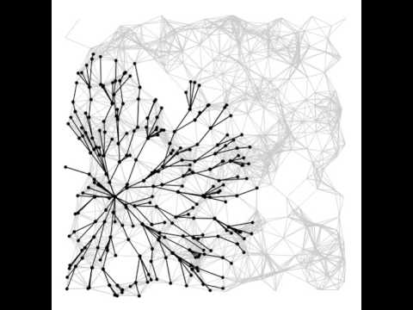
Prim’s vs. Dijkstra’s (visual)
Prim’s Algorithm
Dijkstra’s Algorithm
Demos courtesy of Kevin Wayne, Princeton University

Slide 28
Prim’s Algorithm Implementation
The natural implementation of the conceptual version of Prim’s algorithm is highly inefficient.
Example: Iterating over purple edges shown is unnecessary and slow.
Can use some cleverness and a PQ to speed things up.
Realistic Implementation Demo (Link)
Very similar to Dijkstra’s!
3
11
1
1
2
2
3
6
5
4
3
s
0
1
1
4
1
2
15
5

Slide 29
Prim’s vs. Dijkstra’s
Prim’s and Dijkstra’s algorithms are exactly the same, except Dijkstra’s considers “distance from the source”, and Prim’s considers “distance from the tree.”
Visit order:
Dijkstra’s algorithm visits vertices in order of distance from the source.
Prim’s algorithm visits vertices in order of distance from the MST under construction.
Relaxation:
Relaxation in Dijkstra’s considers an edge better based on distance to source.
Relaxation in Prim’s considers an edge better based on distance to tree.

Slide 30
Prim’s Implementation (Pseudocode, 1/2)
public class PrimMST {
public PrimMST(EdgeWeightedGraph G) {
edgeTo = new Edge[G.V()];
distTo = new double[G.V()];
marked = new boolean[G.V()];
fringe = new SpecialPQ<Double>(G.V());
distTo[s] = 0.0;
setDistancesToInfinityExceptS(s);
insertAllVertices(fringe);
/* Get vertices in order of distance from tree. */
while (!fringe.isEmpty()) {
int v = fringe.delMin();
scan(G, v);
}
}
...
Fringe is ordered by distTo tree. Must be a specialPQ like Dijkstra’s.
Get vertex closest to tree that is unvisited.
Scan means to consider all of a vertices outgoing edges.

Slide 31
Prim’s Implementation (Pseudocode, 2/2)
while (!fringe.isEmpty()) {
int v = fringe.delMin();
scan(G, v);
}
Important invariant, fringe must be ordered by current best known distance from tree.
private void scan(EdgeWeightedGraph G, int v) {
marked[v] = true;
for (Edge e : G.adj(v)) {
int w = e.other(v);
if (marked[w]) { continue; }
if (e.weight() < distTo[w]) {
distTo[w] = e.weight();
edgeTo[w] = e;
pq.decreasePriority(w, distTo[w]);
}
}
}
Vertex is closest, so add to MST.
Already in MST, so go to next edge.
Better path to a particular vertex found, so update current best known for that vertex.

Slide 32
Prim’s Runtime
What is the runtime of Prim’s algorithm?
Assume all PQ operations take O(log(V)) time.
Give your answer in Big O notation.
while (!fringe.isEmpty()) {
int v = fringe.delMin();
scan(G, v);
}
private void scan(EdgeWeightedGraph G, int v) {
marked[v] = true;
for (Edge e : G.adj(v)) {
int w = e.other(v);
if (marked[w]) { continue; }
if (e.weight() < distTo[w]) {
distTo[w] = e.weight();
edgeTo[w] = e;
pq.decreasePriority(w, distTo[w]);
}
}
}

Slide 33
Prim’s Algorithm Runtime
Priority Queue operation count, assuming binary heap based PQ:
Insertion: V, each costing O(log V) time.
Delete-min: V, each costing O(log V) time.
Decrease priority: O(E), each costing O(log V) time.
Operation not discussed in lecture, but it was in lab 10.
Overall runtime: O(V*log(V) + V*log(V) + E*logV).
Assuming E > V, this is just O(E log V).
 | # Operations | Cost per operation | Total cost
PQ add | V | O(log V) | O(V log V)
PQ delMin | V | O(log V) | O(V log V)
PQ decreasePriority | O(E) | O(log V) | O(E log V)

Slide 34
Kruskal’s Algorithm

Slide 35
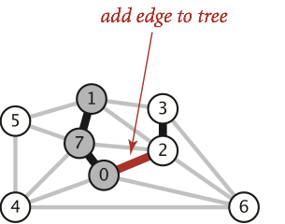
Kruskal’s Algorithm
Initially mark all edges gray.
Consider edges in increasing order of weight.
Add edge to MST (mark black) unless doing so creates a cycle.
Repeat until V-1 edges.
Conceptual Kruskal’s Algorithm Demo (Link)
Realistic Kruskal’s Algorithm Implementation Demo (Link)
Why does Kruskal’s work? Special case of generic MST algorithm.
Suppose we add edge e = v->w.
Side 1 of cut is all vertices connected to v, side 2 is everything else.
No crossing edge is black (since we don’t allow cycles).
No crossing edge has lower weight (consider in increasing order).

Slide 36
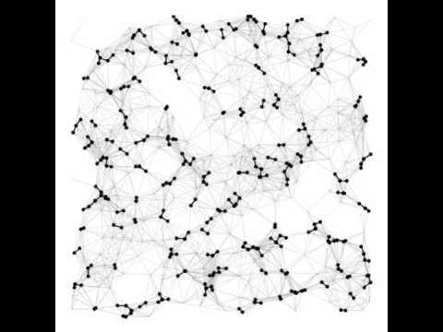
Prim’s vs. Kruskal’s
Prim’s Algorithm
Kruskal’s Algorithm
Demos courtesy of Kevin Wayne, Princeton University

Slide 37
Kruskal’s Implementation (Pseudocode)
What is the runtime of Kruskal’s algorithm?
Assume all PQ operations take O(log(V)) time.
Assume all WQU operations take O(log* V) time.
Give your answer in Big O notation.
public class KruskalMST {
private List<Edge> mst = new ArrayList<Edge>();
public KruskalMST(EdgeWeightedGraph G) {
MinPQ<Edge> pq = new MinPQ<Edge>();
for (Edge e : G.edges()) {
pq.insert(e);
}
WeightedQuickUnionPC uf =
new WeightedQuickUnionPC(G.V());
while (!pq.isEmpty() && mst.size() < G.V() - 1) {
Edge e = pq.delMin();
int v = e.from();
int w = e.to();
if (!uf.connected(v, w)) {
uf.union(v, w);
mst.add(e);
} } } }

Slide 38
Kruskal’s Runtime
Fun fact: In HeapSort lecture, we discuss how do this step in O(E) time using “bottom-up heapification”.
Kruskal’s algorithm on previous slide is O(E log E).
Note: If we use a pre-sorted list of edges (instead of a PQ), then we can simply iterate through the list in O(E) time, so overall runtime is O(E + V log*V + E log* V) = O(E log*V).
Operation | Number of Times | Time per Operation | Total Time
Insert | E | O(log E) | O(E log E)
Delete minimum | O(E) | O(log E) | O(E log E)
union | O(V) | O(log* V) | O(V log* V)
isConnected | O(E) | O(log* V) | O(E log*V)

Slide 39
Shortest Paths and MST Algorithms Summary
Problem | Algorithm | Runtime (if E > V) | Notes
Shortest Paths | Dijkstra’s | O(E log V) | Fails for negative weight edges.
MST | Prim’s | O(E log V) | Analogous to Dijkstra’s.
MST | Kruskal’s | O(E log E) | Uses WQUPC.
MST | Kruskal’s with pre-sorted edges | O(E log* V) | Uses WQUPC.
Question: Can we do better than O(E log* V)?

Slide 40
170 Spoiler: State of the Art Compare-Based MST Algorithms
year | worst case | discovered by
1975 | E log log V | Yao
1984 | E log* V | Fredman-Tarjan
1986 | E log (log* V) | Gabow-Galil-Spencer-Tarjan
1997 | E α(V) log α(V) | Chazelle
2000 | E α(V) | Chazelle
2002 | optimal (link) | Pettie-Ramachandran
??? | E ??? | ???
(Slide Courtesy of Kevin Wayne, Princeton University)

Slide 41
Citations
Tree fire: http://www.miamidade.gov/fire/library/hotlines/2011-december_files/tree-fire.jpg
Bicycle routes in Seattle: https://www.flickr.com/photos/ewedistrict/21980840
Cancer MST: http://www.bccrc.ca/ci/ta01_archlevel.html

